Slide 1
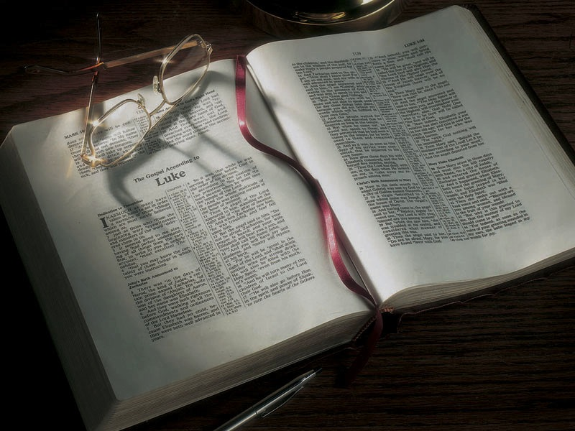

Slide 2
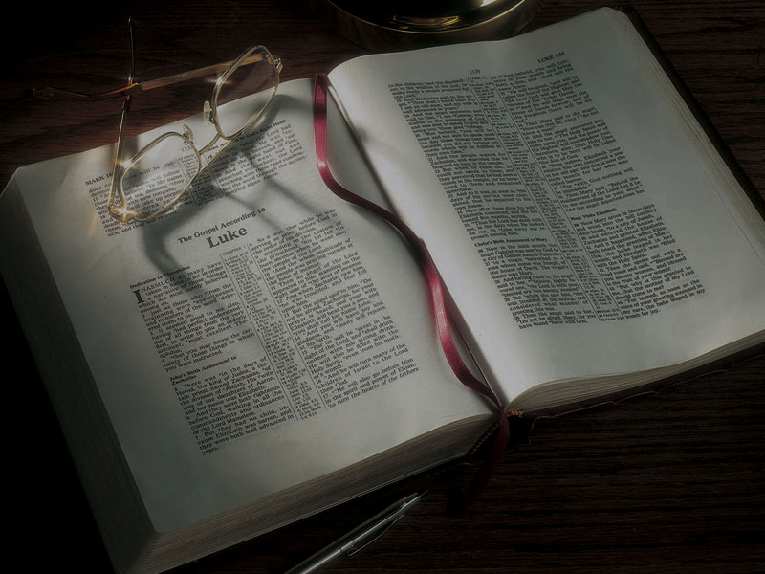
The Gospels
The Birth and Childhood of John the Baptist and the Angel’s Message to Joseph

Slide 3
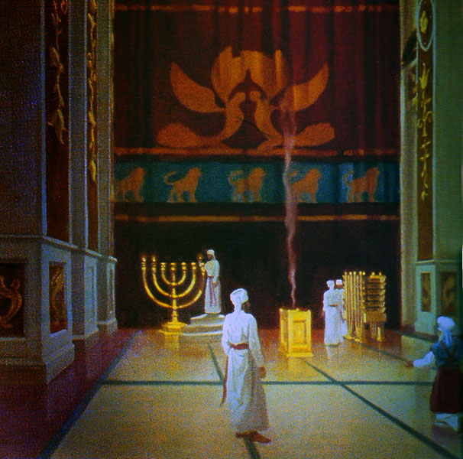

Slide 4
Luke 1:57-80
57 Now Elizabeth’s full time came for her to be delivered, and she brought forth a son.
58 When her neighbors and relatives heard how the Lord had shown great mercy to her, they rejoiced with her.
59 So it was, on the eighth day, that they came to circumcise the child; and they would have called him by the name of his father, Zacharias.
60 His mother answered and said, “No; he shall be called John.

Slide 5
Luke 1:57-80
61 But they said to her, “There is no one among your relatives who is called by this name.”
62 So they made signs to his father—what he would have him called.
63 And he asked for a writing tablet, and wrote, saying, “His name is John.” So they all marveled.

Slide 6
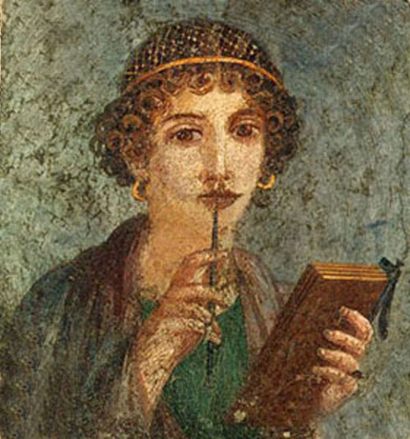

Slide 7
Luke 1:57-80
64 Immediately his mouth was opened and his tongue loosed, and he spoke, praising God.
65 Then fear came on all who dwelt around them; and all these sayings were discussed throughout all the hill country of Judea.
66 And all those who heard them kept them in their hearts, saying, “What kind of child will this be?” And the hand of the Lord was with him.

Slide 8
Luke 1:57-80
67 Now his father Zacharias was filled with the Holy Spirit, and prophesied, saying:
68 “Blessed is the Lord God of Israel, for He has visited and redeemed His people,
69 And has raised up a horn of salvation for us in the house of His servant David,

Slide 9
Luke 1:57-80
67 Now his father Zacharias was filled with the Holy Spirit, and prophesied, saying:
68 “Blessed is the Lord God of Israel, for He has visited and redeemed His people,
69 And has raised up a horn of salvation for us in the house of His servant David,
Psalm 18:2
The LORD is my rock and my fortress and my deliverer; my God, my strength, in whom I will trust; my shield and the horn of my salvation, my stronghold.

Slide 10
Luke 1:57-80
70 As He spoke by the mouth of His holy prophets, who have been since the world began,

Slide 11
Luke 1:57-80
70 As He spoke by the mouth of His holy prophets, who have been since the world began,
Genesis 3:14-15
14 So the LORD God said to the serpent: “Because you have done this . . .
15 I will put enmity between you and the woman, and between your seed and her Seed; He shall bruise your head, and you shall bruise His heel.”

Slide 12
Jude 14-15
14 Now Enoch, the seventh from Adam, prophesied about these men also, saying, “Behold, the Lord comes with ten thousands of His saints,
15 “to execute judgment on all, to convict all who are ungodly among them of all their ungodly deeds which they have committed in an ungodly way, and of all the harsh things which ungodly sinners have spoken against Him.”

Slide 13
Exodus 20:18-19
18 Now all the people witnessed the thunderings, the lightning flashes, the sound of the trumpet, and the mountain smoking; and when the people saw it, they trembled and stood afar off.
19 Then they said to Moses, “You speak with us, and we will hear; but let not God speak with us, lest we die.”

Slide 14
Luke 1:57-80
70 As He spoke by the mouth of His holy prophets, who have been since the world began,
71 That we should be saved from our enemies and from the hand of all who hate us,

Slide 15
Luke 1:57-80
70 As He spoke by the mouth of His holy prophets, who have been since the world began,
71 That we should be saved from our enemies and from the hand of all who hate us,
Psalm 106:10
He saved them from the hand of him who hated them, and redeemed them from the hand of the enemy.

Slide 16
1 Peter 5:8
Be sober, be vigilant; because your adversary the devil walks about like a roaring lion, seeking whom he may devour.

Slide 17
1 Peter 5:8
Be sober, be vigilant; because your adversary the devil walks about like a roaring lion, seeking whom he may devour.
1 Corinthians 15:26
The last enemy that will be destroyed is death.

Slide 18
Hebrews 13:6
So we may boldly say: “The LORD is my helper;
I will not fear. What can man do to me?”

Slide 19
Luke 1:57-80
70 As He spoke by the mouth of His holy prophets, who have been since the world began,
71 That we should be saved from our enemies and from the hand of all who hate us,
72 To perform the mercy promised to our fathers and to remember His holy covenant,
73 The oath which He swore to our father Abraham:

Slide 20
Luke 1:57-80
70 As He spoke by the mouth of His holy prophets, who have been since the world began,
71 That we should be saved from our enemies and from the hand of all who hate us,
72 To perform the mercy promised to our fathers and to remember His holy covenant,
73 The oath which He swore to our father Abraham:

Slide 21
Luke 1:57-80
70 As He spoke by the mouth of His holy prophets, who have been since the world began,
71 That we should be saved from our enemies and from the hand of all who hate us,
72 To perform the mercy promised to our fathers and to remember His holy covenant,
73 The oath which He swore to our father Abraham:

Slide 22
Luke 1:57-80
70 As He spoke by the mouth of His holy prophets, who have been since the world began,
71 That we should be saved from our enemies and from the hand of all who hate us,
72 To perform the mercy promised to our fathers and to remember His holy covenant,
73 The oath which He swore to our father Abraham:

Slide 23
Luke 1:57-80
74 To grant us that we, being delivered from the hand of our enemies, might serve Him without fear,
75 In holiness and righteousness before Him all the days of our life.
76 “And you, child, will be called the prophet of the Highest; for you will go before the face of the Lord to prepare His ways,

Slide 24
Malachi 3:1
Behold, I send My messenger, and he will prepare the way before Me. And the Lord, whom you seek, will suddenly come to His temple, even the Messenger of the covenant, in whom you delight. Behold, He is coming,” says the Lord of hosts.

Slide 25
Luke 1:57-80
74 To grant us that we, being delivered from the hand of our enemies, might serve Him without fear,
75 In holiness and righteousness before Him all the days of our life.
76 “And you, child, will be called the prophet of the Highest; for you will go before the face of the Lord to prepare His ways,
77 To give knowledge of salvation to His people by the remission of their sins,
78 Through the tender mercy of our God, with which the Dayspring from on high has visited us;

Slide 26
Malachi 4:2
But to you who fear My name the Sun of Righteousness shall arise with healing in His wings.

Slide 27
Luke 1:57-80
79 To give light to those who sit in darkness and the shadow of death, to guide our feet into the way of peace.”
80 So the child grew and became strong in spirit, and was in the deserts till the day of his manifestation [appearance] to Israel.

Slide 28
Matthew 1:18-25
18 Now the birth of Jesus Christ was as follows: After His mother Mary was betrothed to Joseph, before they came together, she was found with child of the Holy Spirit.
19 Then Joseph her husband, being a just man, and not wanting to make her a public example, was minded to put her away secretly.

Slide 29
Matthew 1:18-25
20 But while he thought about these things, behold, an angel of the Lord appeared to him in a dream, saying, “Joseph, son of David, do not be afraid to take to you Mary your wife, for that which is conceived in her is of the Holy Spirit.
21 “And she will bring forth a Son, and you shall call His name JESUS, for He will save His people from their sins.”

Slide 30
Matthew 1:18-25
22 So all this was done that it might be fulfilled which was spoken by the Lord through the prophet, saying:
23 “Behold, the virgin shall be with child, and bear a Son, and they shall call His name Immanuel,” which is translated, “God with us.”

Slide 31
Matthew 1:18-25
22 So all this was done that it might be fulfilled which was spoken by the Lord through the prophet, saying:
23 “Behold, the virgin shall be with child, and bear a Son, and they shall call His name Immanuel,” which is translated, “God with us.”
Isaiah 7:14
Therefore the Lord Himself will give you a sign: Behold, the virgin shall conceive and bear a Son, and shall call His name Immanuel.

Slide 32
John 1:1-18
In the beginning was the word, and the Word was with God, and the Word was God . . . and the Word became flesh and dwelt among us.

Slide 33
Matthew 1:18-25
24 Then Joseph, being aroused from sleep, did as the angel of the Lord commanded him and took to him his wife,
25 and did not know her till she had brought forth her firstborn Son. And he called His name JESUS.

Slide 34
Matthew 12:46-47
46 While He was still talking to the multitudes, behold, His mother and brothers stood outside, seeking to speak with Him.—
47 Then one said to Him, “Look, Your mother and Your brothers are standing outside, seeking to speak with You.”

Slide 35
Matthew 13:54-56
54 And when He had come to His own country, He taught them in their synagogue, so that they were astonished and said, “Where did this Man get this wisdom and these mighty works? 55 Is this not the carpenter’s son? Is not His mother called Mary? And His brothers James, Joses, Simon, and Judas? 56 “And His sisters, are they not all with us? Where then did this Man get all these things?”

Slide 40
Matthew 1:17
17 So all the generations from Abraham to David are fourteen generations, from David until the captivity in Babylon are fourteen generations, and from the captivity in Babylon until the Christ are fourteen generations.

Slide 41
Matthew 1:17
17 So all the generations from Abraham to David are fourteen generations, from David until the captivity in Babylon are fourteen generations, and from the captivity in Babylon until the Christ are fourteen generations.
Roman numerals: I = 1, V = 5, X = 10, L = 50,
C = 100, D = 500, M = 1,000
Hebrew numerals: A = 1, B = 2,… D = 4, V = 6
David = D-V-D D = 4, V = 6, D = 4 DVD = 14
DAVID DAVID DAVID

Slide 42
The Gospels

